Slide 1
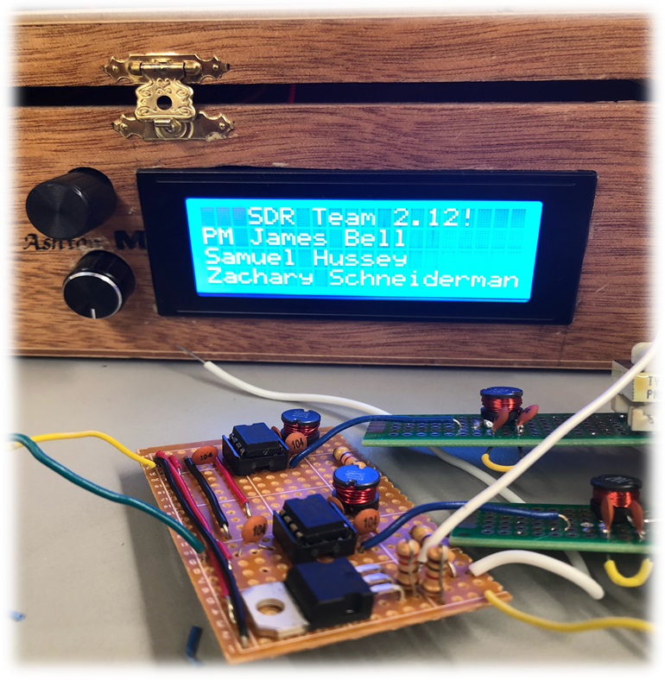
2.12 Software Defined Radio
Sponsored By: Texas State University
James Bell, Samuel Hussey, Zachary Schneiderman
Faculty Advisor: Dr. Stapleton
Notes:
PM starts presentation. Everyone speaks. You decide who goes when.

Slide 2
Project Overview
Low cost half-duplex Software Defined Radio for students to practice with, learn on, and replicate.
Requirements:
Under $300
20m and 80m amateur radio bands
Single side-band operation

Slide 3
Project Motivation
The problem:
Students often cannot afford or do not have access to pre-built software defined transceivers for high frequency operation.
The solution:
An SDR Transceiver to make amateur radio more accessible for students in order to facilitate learning and an understanding of radio.
Notes:
Why are you doing this project? What’s important / needed / beneficial about it? Why is this a good senior design project? MAKE FONT BIG

Slide 4
Project Goals
Goals of Project
Stretch Goals of Project
Under $300
Full pin by pin schematics
Detailed code
Operate on 20m and 80m bands
Single side-band modulation and demodulation
Custom PCB
Battery Operated for 4 hours
Headphone Capable
Build Kit for radio
Notes:
If no stretch goals then delete the text box on the right, and expand the one on the left. DO NOT ELABORATE ON THE GOALS, JUST STATE THEM QUICKLY AND MOVE ON!!!

Slide 5
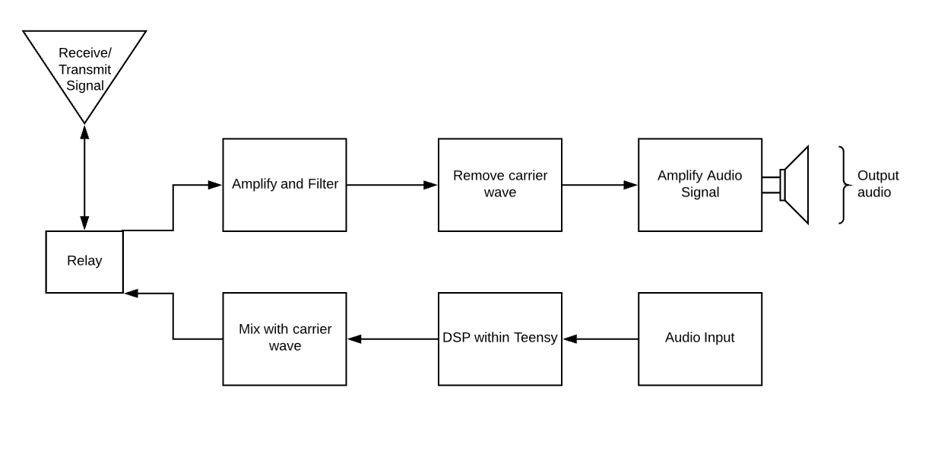
Top Level Block Diagram

Slide 6
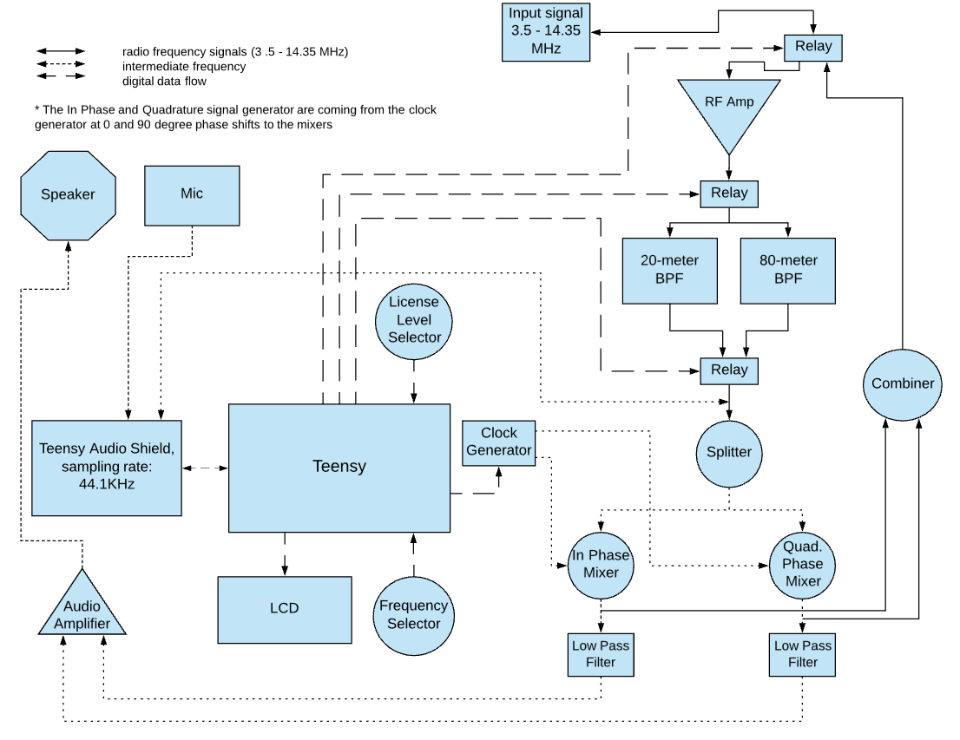
Signal Flow Chart

Slide 7
What has been delivered
Demodulated SSB Signals on 20- and 80- meter bands
LED indicator for power
Volume control
Frequencies of operation limited to 20- and 80- meter bands
Frequency tuner
Display
Frequency tuned to
Upper or Lower Sideband Selected
Band tuned to (20- or 80- meter band)
License level selected

Slide 8
Results
Parameter | Min | Max | Result | Method
5V Regulator Voltage | 3.3V | 6.0V | 4.998V Pass | Measure regulator voltage output
7V Regulator Voltage | 6.2V | 7.4V | 7.06V Pass | Measure regulator voltage output
RF Amp Gain | 18 | 25 | 20 Pass | Compare input to output voltage
80m BPF Loss | 0 dB | 2.5 dB | 0.9 dB Pass | Compare input to output voltage at center freq
20m BPF Loss | 0 dB | 4.5 dB | 4.3 dB Pass | Compare input to output voltage at center freq
Speaker Volume | 0 dB | 70dB | 65 dB Pass | Calibrated decibel meter at speaker
Signal Processing Latency | 0 ms | 1 ms | 451 us Pass | Measure signal input to output time on scope
Transmit power | 18mW | 31mW | 0mW Fail | Measure output power with oscilloscope
Notes:
BRIEFLY summarize the results of your efforts in tabular form.

Slide 9
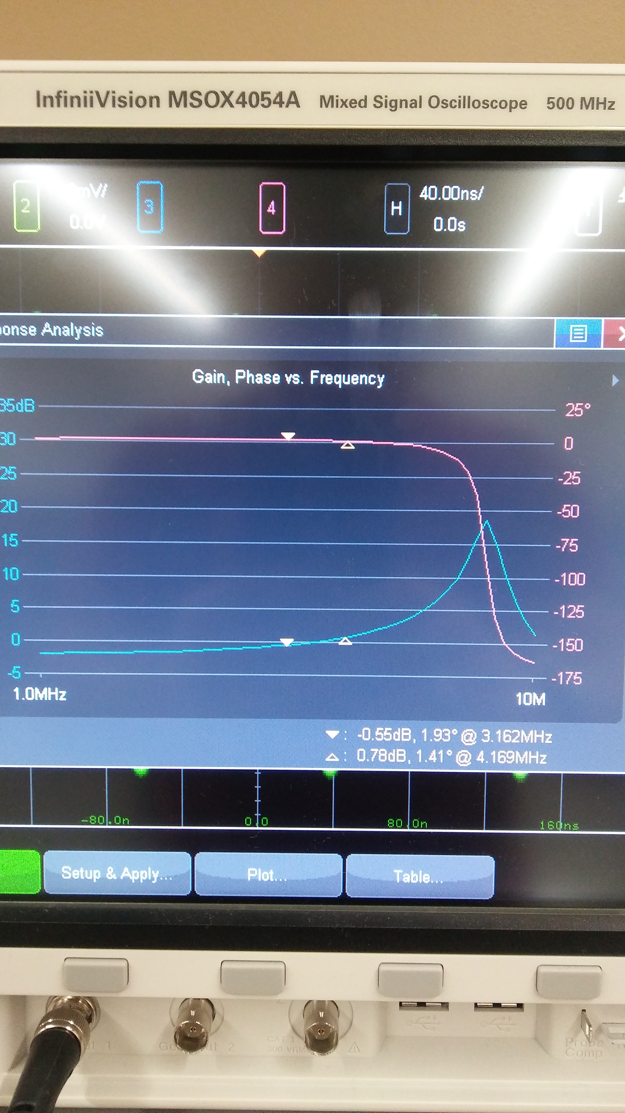
Tests Plan Results Continued
Radio will only operate at 3.50 - 4.00 MHz and 14.00 - 14.35MHz.
3.50-4.00MHz waveform with gain

Slide 10
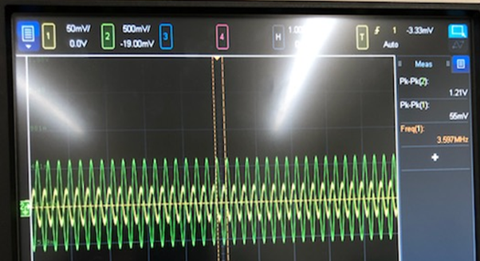
Tests Plan Results Continued
Radio will only operate at 3.50 - 4.00 MHz and 14.00 - 14.35MHz.
3.50-4.00MHz waveform with gain of 0.9dB

Slide 11
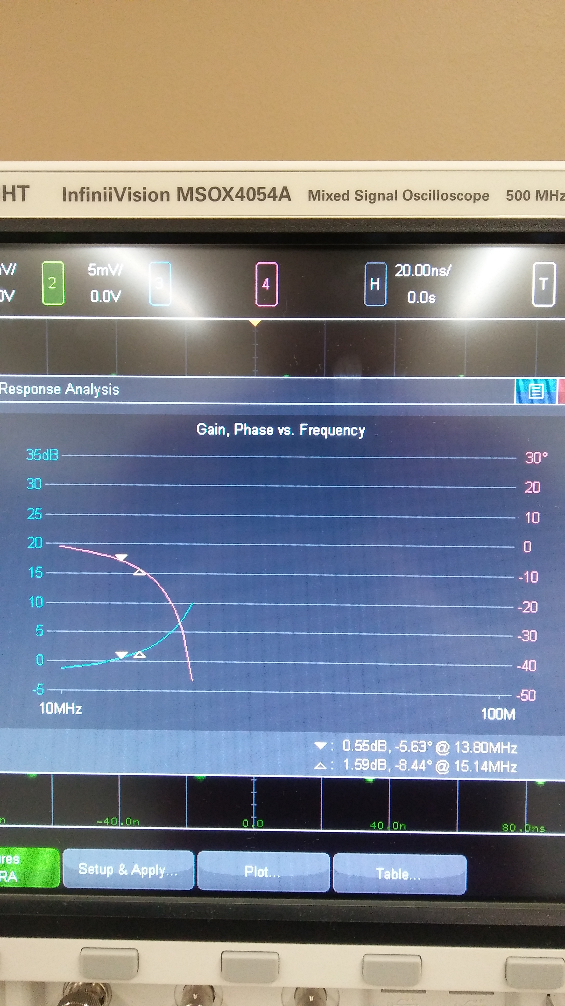
Tests Plan Results Continued
Radio will only operate at 3.5-4.0 MHz and 14.00 – 14.35MHz.
14.00-14.35MHz waveform with gain

Slide 12
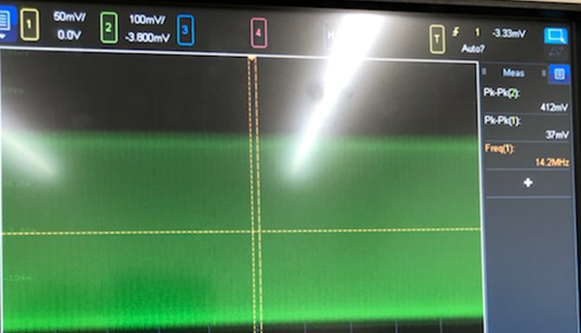
Tests Plan Results Continued
Radio will only operate at 3.5-4.0 MHz and 14.00 – 14.35MHz.
14.00-14.35MHz waveform with gain of 4.3dB

Slide 13
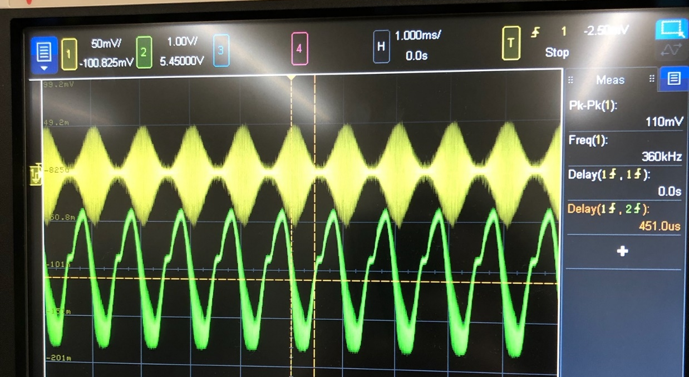
Tests Plan Results Continued
Latency under 100ms
Yellow is input signal from waveform generator
Green is output from speaker
451us < 100ms - Passed

Slide 14
System Deficiencies
Ringing in speaker output, possible standing waves causing ringing.
Will need to verify with a voice or music sample signal to see if causes significant disruption in using the radio.
Transmit functions have not been implemented yet. Moving forward, we need:
Further research into microphone setup.
Code to establish legal transmission frequencies for selected band plan.
Notes:
Delete if you met all goals and all specifications and there were no deficiencies.

Slide 15
Lessons Learned
A proper microcontroller requires more than just the required specs; documentation and support are key aspects as well.
Know the capabilities of your testing equipment.
In-circuit testing will likely yield different results than simulations, be prepared to adjust designs at any point in the implementation process.
Notes:
Think about this; use it to promote yourselves!

Slide 16
Acknowledgments
Thank you to Dr. Stapleton, Mr. Welker, Dr. Compeu, and Dr. Aslan for your guidance and mentorship throughout the duration of our senior design experience.
A special thank you to Charlie Morris for sharing this project with the world and allowing us to build upon the foundation he created.
Notes:
Be brief!!

